Slide 1
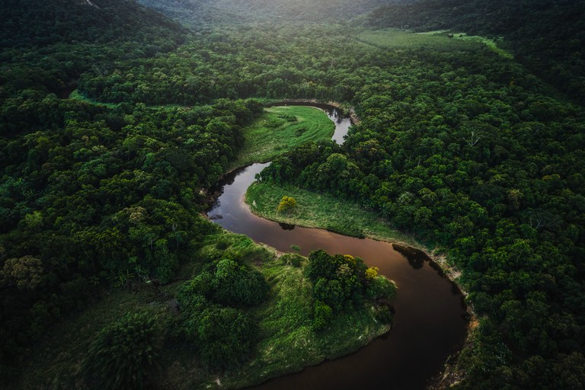
Summarizing time-series land cover change using Mapbiomas data
Aiyin Zhang，Jiang He， Li Xi
GEOG 260/360 GIS & Land Change Models

Slide 2
Objective
Our objective is to develop methods that can summarize critical land change information from time-series land cover maps
We aim to create maps and graphs that are both innovative and able to effectively communicate important information that are helpful to our intended audiences beyond this semester, including the MapBiomas team, and potentially, remote sensing specialists and land change scientists.

Slide 3
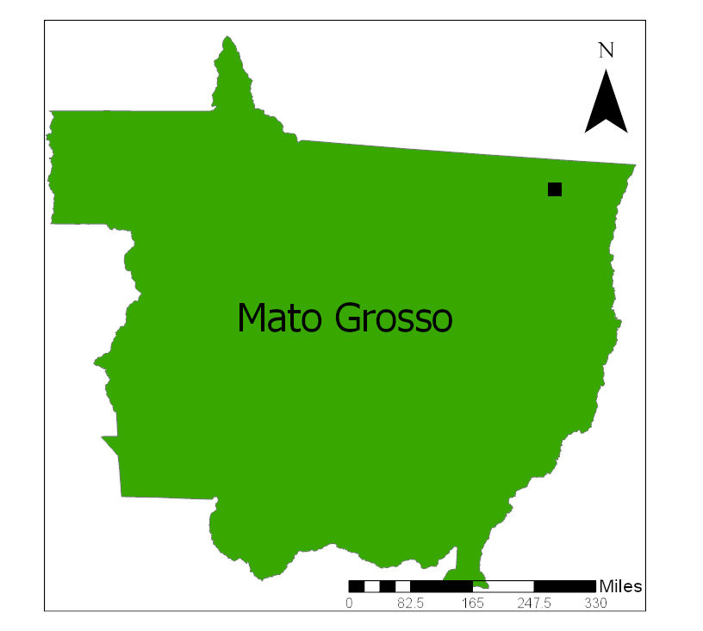
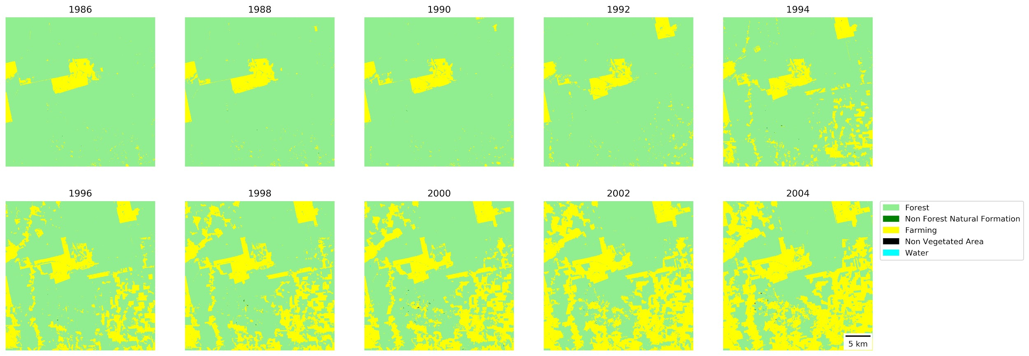
Data and Study area
Data Source: Mapbiomas land cover collection https://mapbiomas.org/download
Size: 1000 pixels *1000 pixels with 30 meters resolution
Time: 10 time points ranging from 1986 to 2004, with a time interval of 2 years between time points
Location: Northeast of the Brazillian state of Mato Grosso
Categories: Forest, Non Forest Natural Formation, Farming, Non Vegetated Area, Water

Slide 4
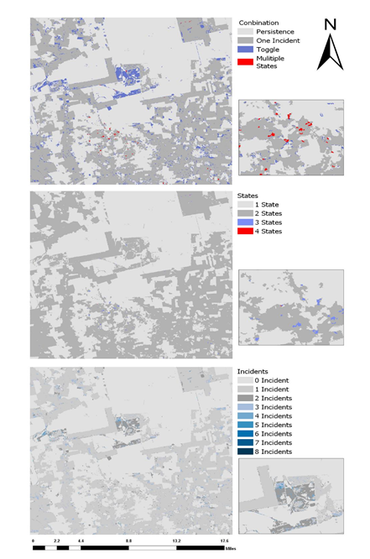
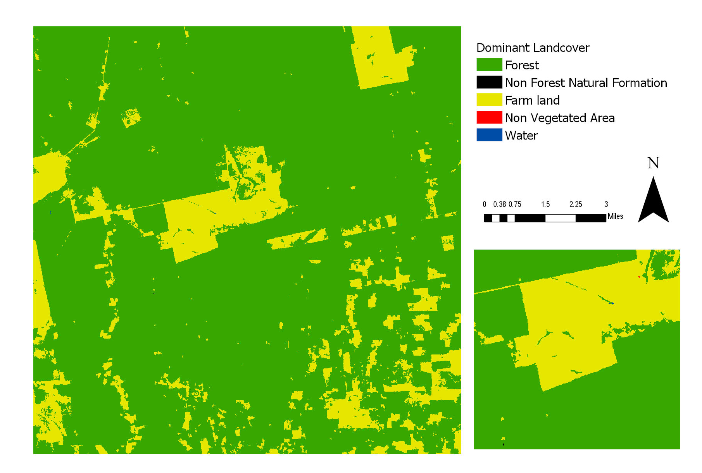
Persistence: Incidents = 0, implies States = 1
One Incident: Incidents = 1, implies States = 2
Toggle: Incidents > 1, States = 2
Multiple States: States > 2, implies Incidents > 1
Mode land cover
Notes:
Persistence indicates no land cover change. One incident indicates that, between 1986 to 2004, the pixel changed and only changed once. Toggle indicates two land cover types switch between each other for at least two times. Multiple states means that land cover change among several land cover types.

Slide 5
Summarizing time-series land cover change using Mapbiomas data
Our graphs are developed to answer the following questions:
What is the area of each land category for each time point?
How much did each land category lost and gained over each time interval?
Among the gross changes of each category, which land cover types did it gained from / lost to?

Slide 6
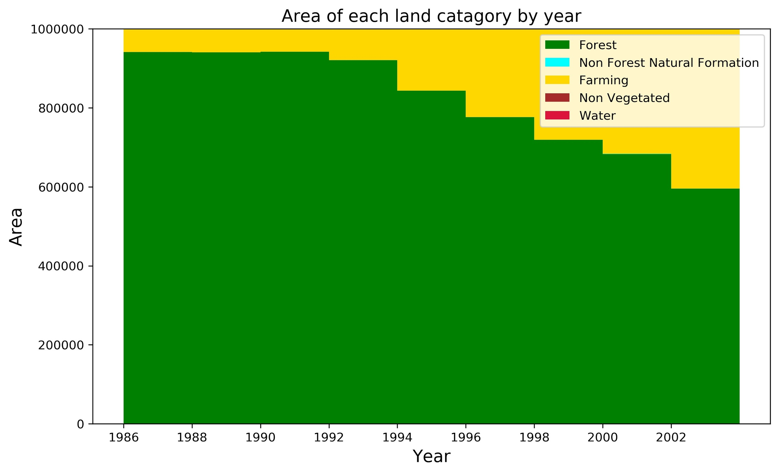
What is the area of each land category for each time point?
Biennial area by category during 1986-2004

Slide 7
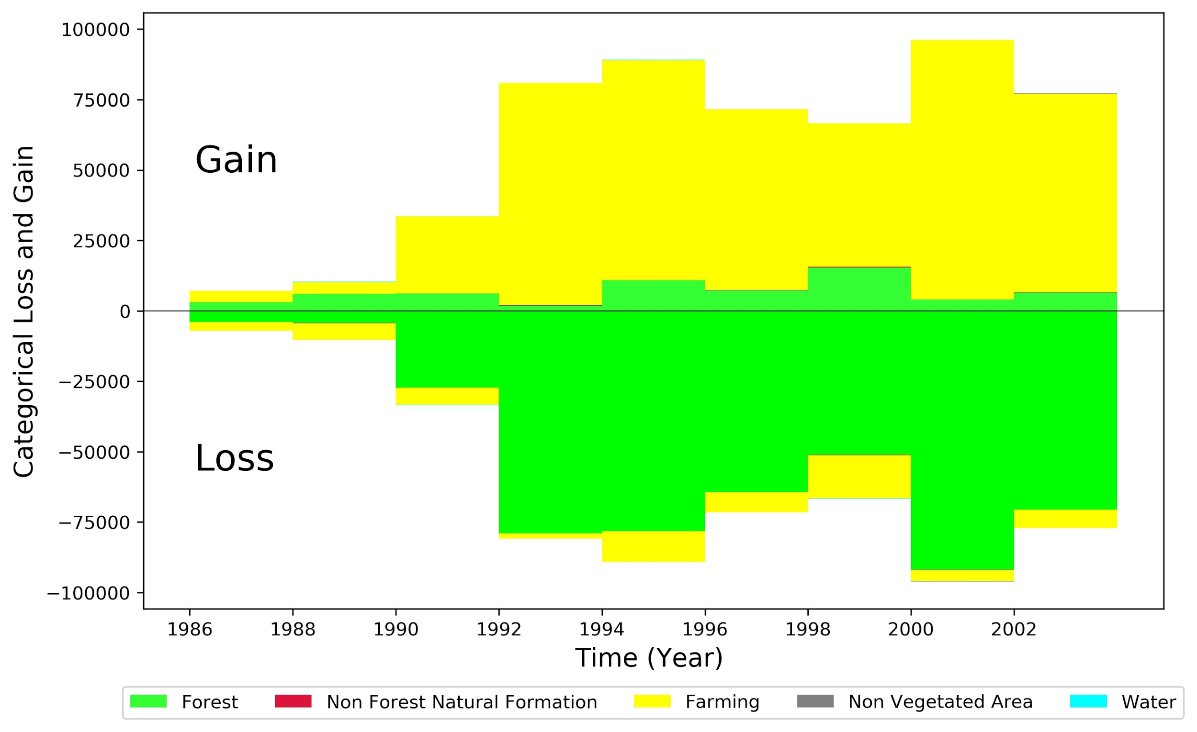
How much did each land category lost and gained over each time interval?
Biennial loss and gain by category during 1986-2004

Slide 8
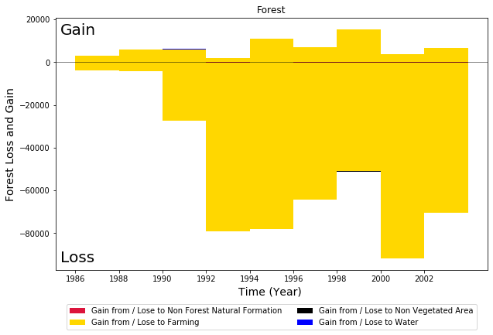
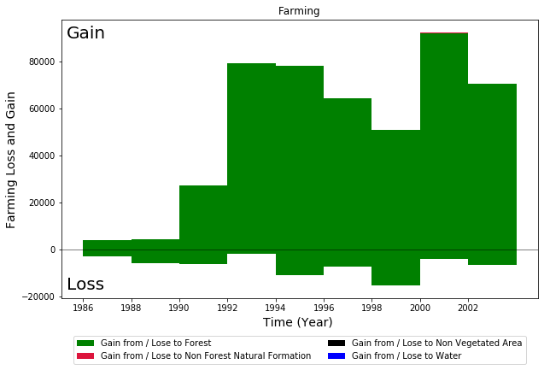
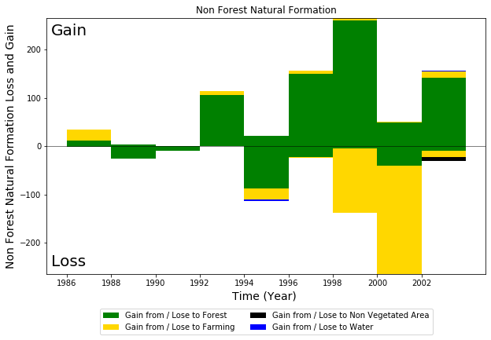
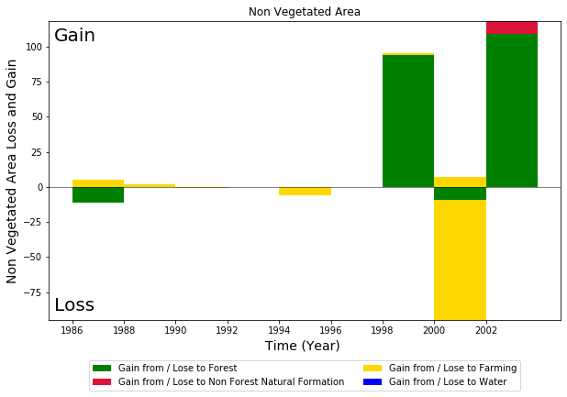
Among the gross changes of each category, which land cover types did it gained from / lost to?
Biennial categorical transitions during 1986-2004

Slide 9
References
Pontius, R. G., Krithivasan, R., Sauls, L., Yan, Y., & Zhang, Y. (2017). Methods to summarize change among land categories across time intervals. Journal of Land Use Science, 12(4), 218–230. https://doi.org/10.1080/1747423X.2017.1338768

Slide 10
Thank You
Questions?

Slide 11
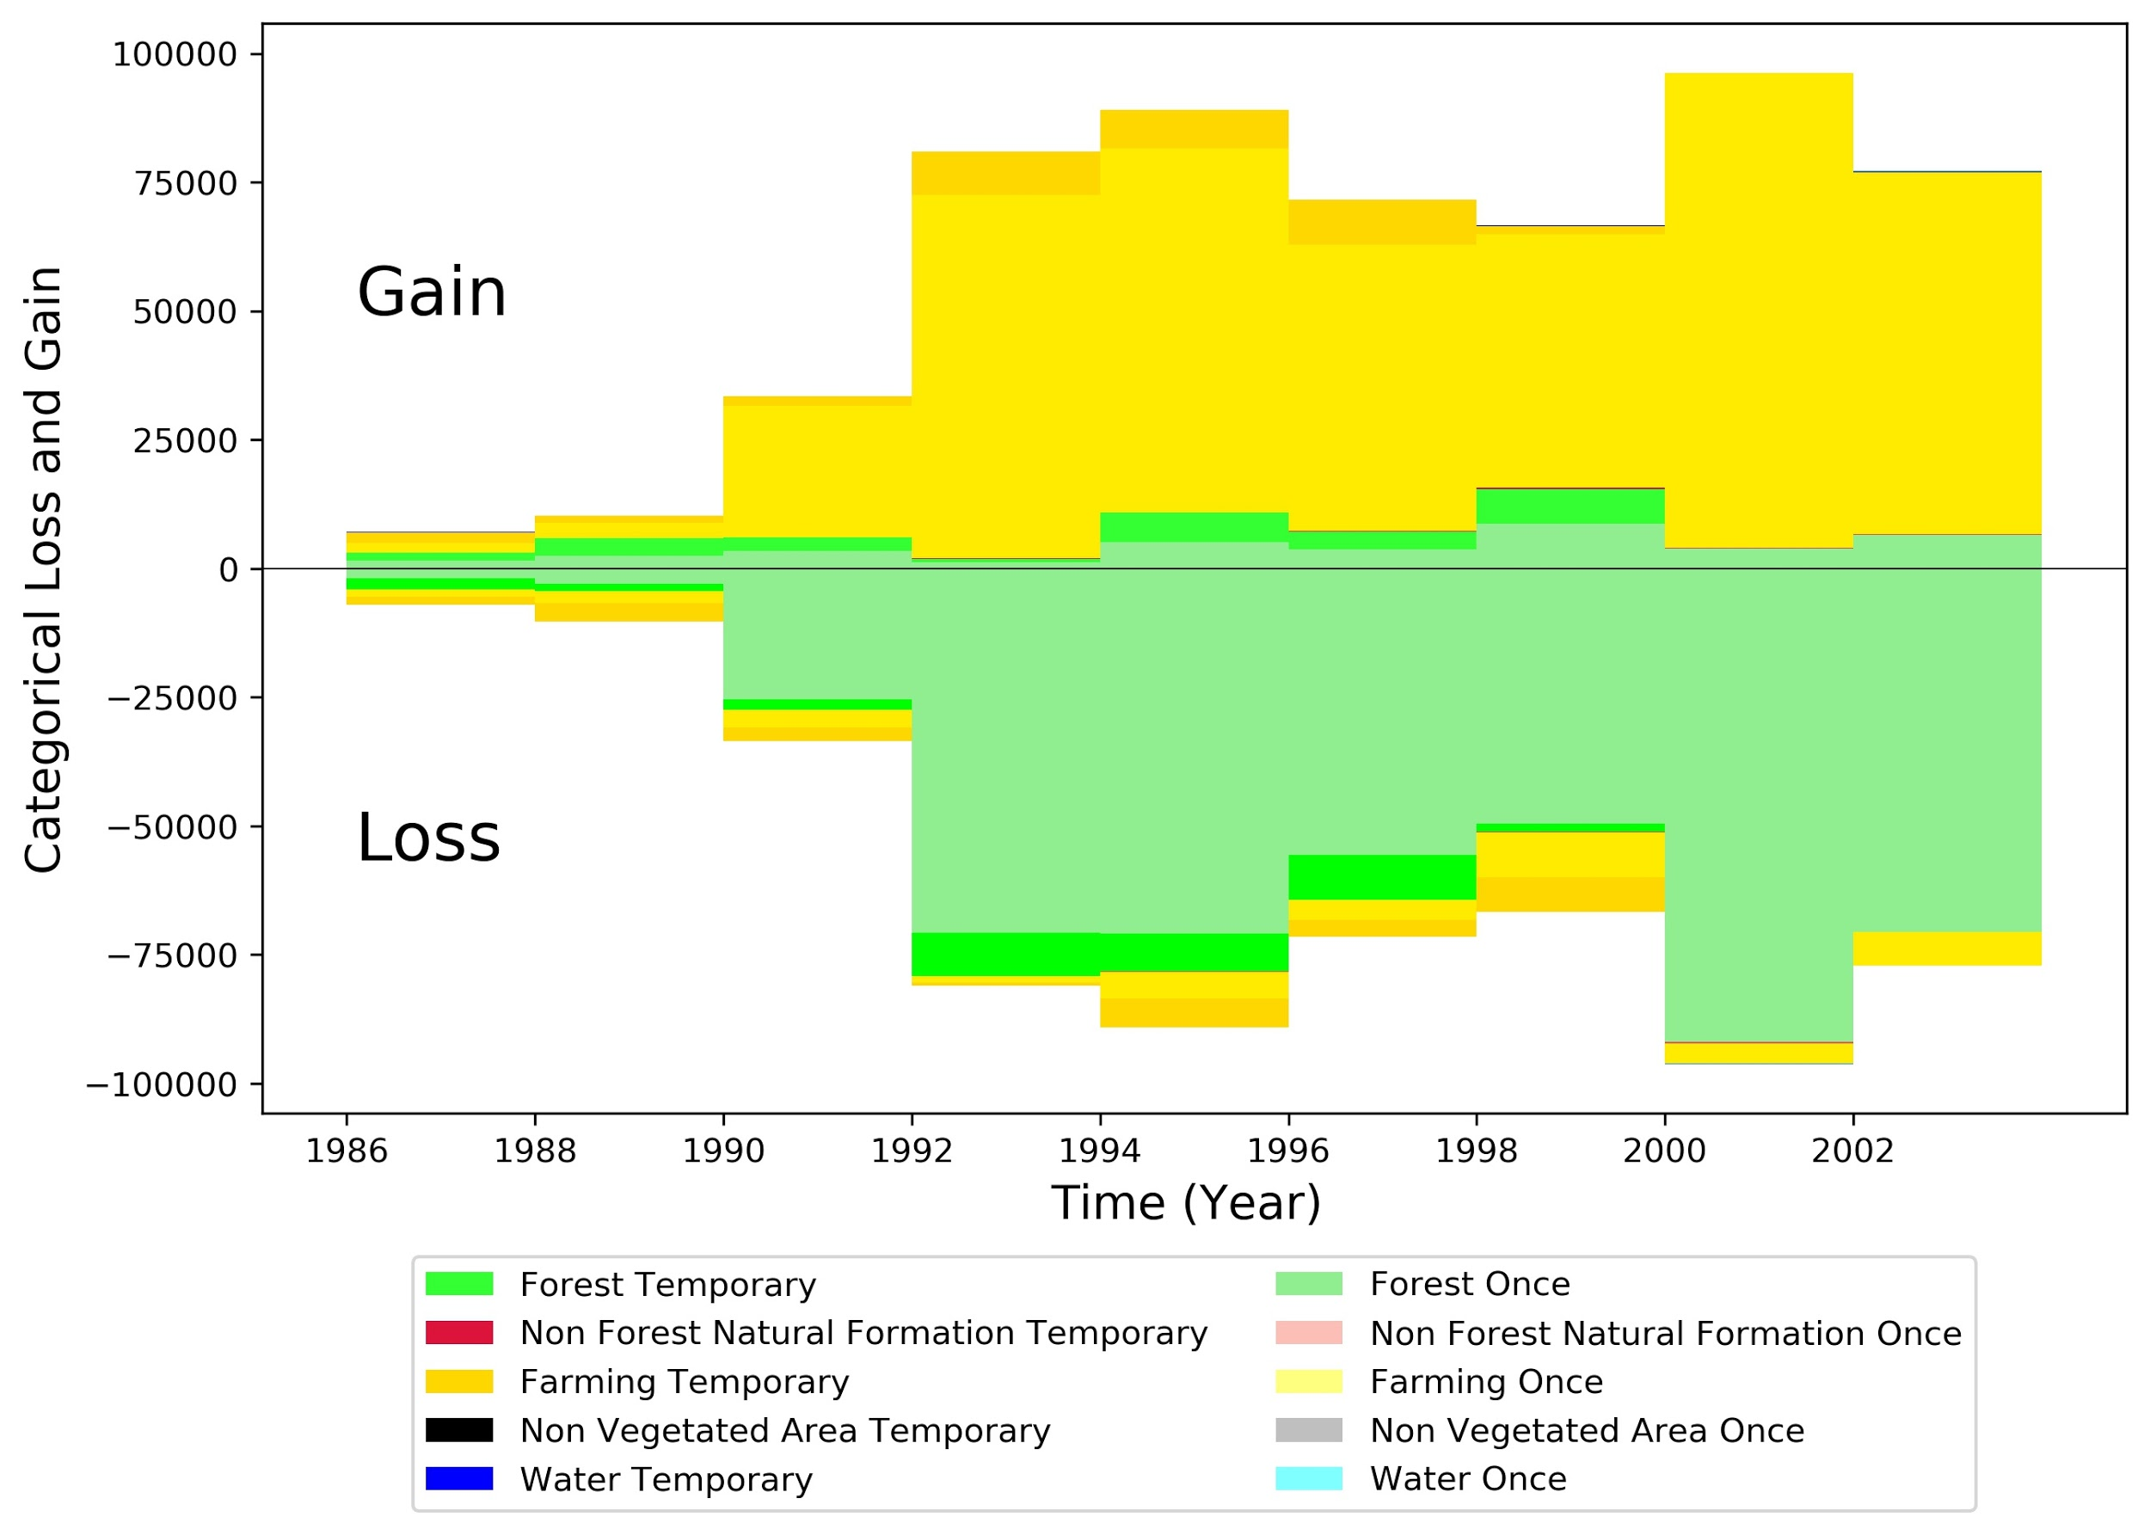
Among the gross changes of each category, how much of them were temporary changes and how much of them did not lose or gain again?
Biennial loss and gain by category during 1986-2004
Gain Once: Gain of category in the corresponding time interval that did not lose subsequently.
Loss Once: Loss of category in the corresponding time interval that did not gain subsequently. But can transit to other categories.
Temporary: Loss or Gain of category in the corresponding time interval that gained or loses again subsequently.
Notes:
+add once and toggle definition

Slide 12
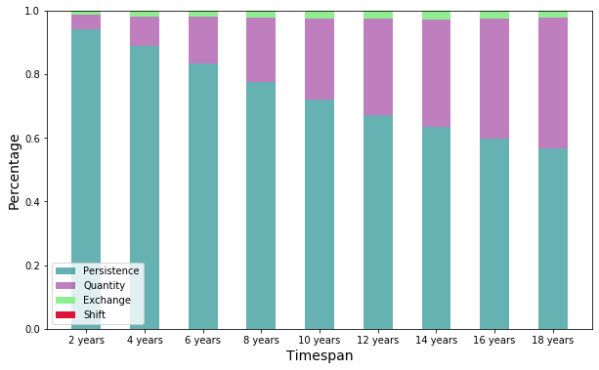
Temporal difference with increasing timespans
Notes:
The statistics only count the start time and end time, not all the time points.
The x axis indicates the timespan of our periods. For example, the first bar shows the land cover change dynamics for two years on average. The second bar shows the change dynamics for four years on average.
The y axis indicates the land cover change percentage.
Persistence means persistent land cover type; Quantity means the absolute/net difference (either land cover decreases or increases) between the start time and end time;
Exchange means, one observation transitions from land cover type A to B, and simultaneously at least one other observation transitions from B to A.
Shift means at least one observation transitions from type A to B while simultaneously at least one observation transitions from C to A. (C is different from B).

Slide 13
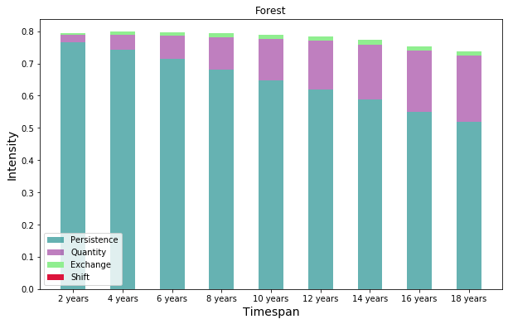
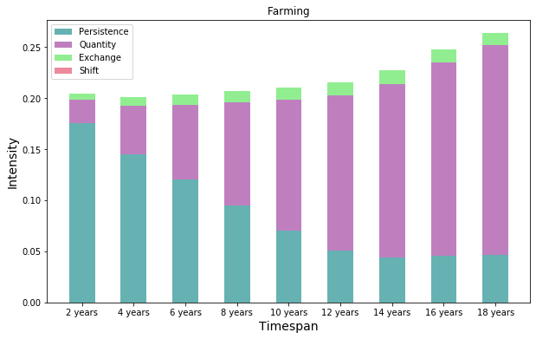
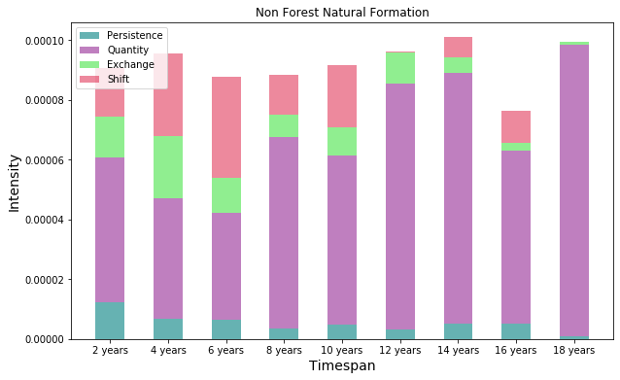
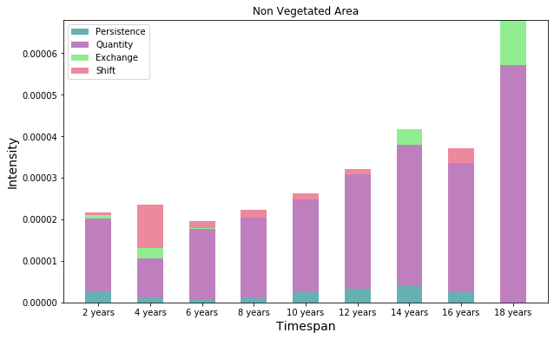
Notes:
Four dominant land cover types’ persistence, quantity, exchange, and shift.

Slide 14
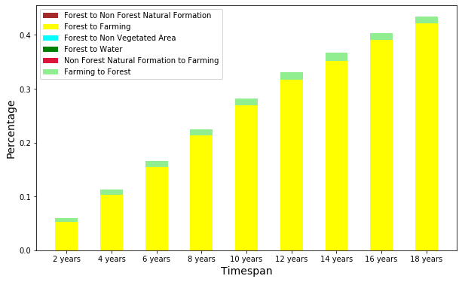
Most frequent transitions with increasing timespans
Notes:
This graph shows frequencies of six dominant land cover transitions. One is forest to farming, the other is farming to forest.

Slide 15
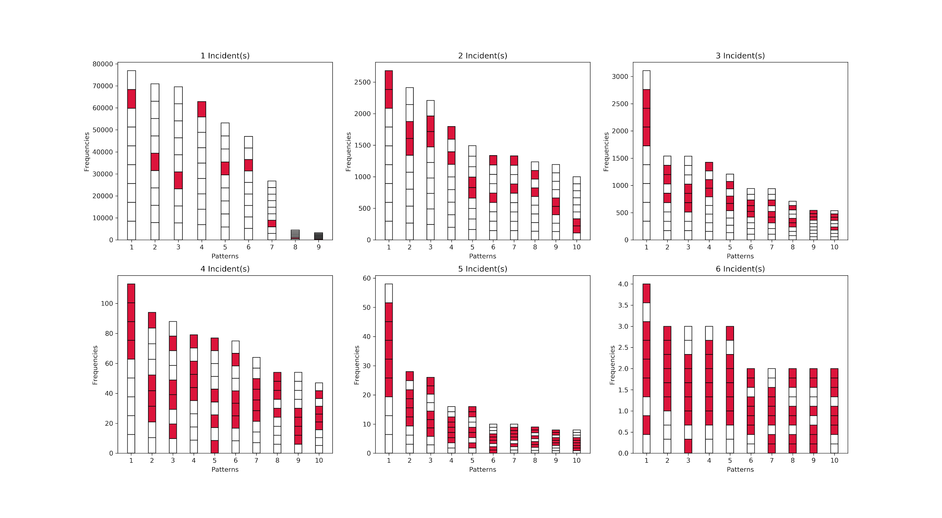
How do we know the pattern of changes?
The maximum number of patterns for a single pixel of the entire time series = 5^10 = 9765625 change patterns = 2^9 = 512
2002-2004
.
.
.
1986-1988
Notes:
This graph shows the temporal patterns of change. First, incident(s) measure the number of changes occurred in different time spans. For example, 1 incident indicates only one time span has occurred changes. Second, the x axis indicates pattern types. The y axis indicates the number of pixels changed. Each section of a bar represents one time span. From bottom up, a bar ranges from 1986-1988 to 2002-2004.

